Slide 1

Analysis of Spam and Non-Spam Text Messages
Devi Varaprasad Abdas
4/18/2024

Slide 2
Abstract
Spam messages, which are frequently seen as digital annoyances, comprise a wide range of uninvited and unwanted communication sent through different digital channels like social media, text messaging, and emails.
This analysis comprises of analyzing text messages and categorizing if they are spam or non-spam messages. This is a process of analyzing, the users regarding text messages that they have received.
Spam
Text Message
Spam Detector
Non-Spam

Slide 3
Project Description
There are several categories of cybercrime activities like:
Phishing
Spam Messages
Online Fraud
Crypto Jacking
Among the various types of cybercrime activities, spam messages are the easiest and fastest way to hack anyone’s phone within a few seconds.
When an individual receives a text message containing links, coupons, a phone number, or random numbers, clicking on the provided links or coupons may facilitate hackers unauthorized access to the phone, compromising both the device and the personal data stored on it.
Reference: https://www.fbi.gov/contact-us/field-offices/springfield/news/internet-crime-complaint-center-releases-2022-statistics

Slide 4
Beneficiaries
Organizations that can gain substantial advantages through this analysis include:
Technology companies.
Social media companies.
Finance companies.
E-commerce companies.
Telecommunication companies.

Slide 5
Research Questions
Regular text (Non-Spam) messages might have similar content as Spam messages, so how can we distinguish if it's Spam or not?
Which analysis method provides effective distinction between Spam and Non-Spam text messages?

Slide 6
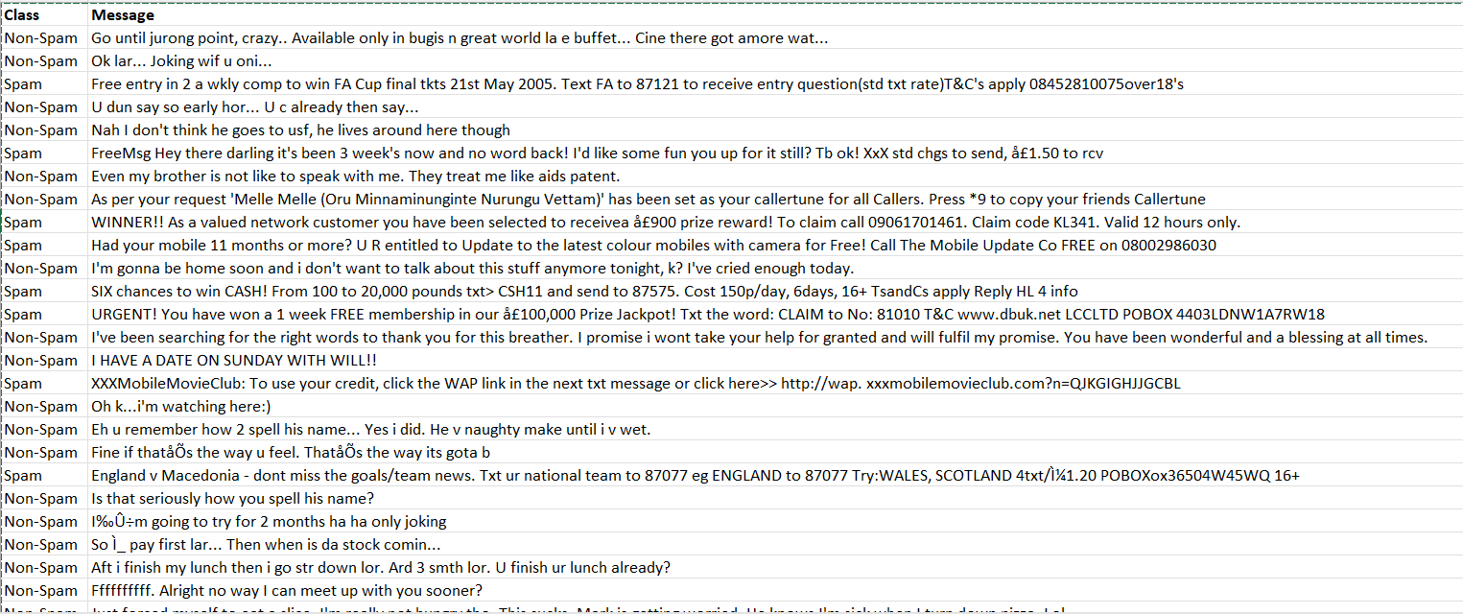
Dataset
This is a sample dataset where data, categorized into Spam and Non-Spam messages, is retrieved from Kaggle. In the dataset, each row consists of the class (Spam or Non-Spam), followed by the message, with the class and message fields being comma-separated.
Reference: https://www.kaggle.com/datasets/uciml/sms-spam-collection-dataset

Slide 7
Dataset
This dataset is a predefined collection retrieved from Kaggle for analytical purposes. Messages in the dataset are classified as 'Spam' or 'Non-Spam' based on various features.
Spam messages often include unsolicited promotions, urgent requests for action or personal information, hyperlinks to questionable websites, and may contain an abundance of sales language or be part of a bulk mailing. They might also use misleading subject lines, excessive capitalization, and special characters to draw attention.
In contrast, Non-Spam messages, also known as 'Ham,' typically involve everyday language and pertain to genuine communication between individuals, displaying a natural flow of conversation without aggressive marketing tactics or suspect content.
Reference: https://www.kaggle.com/datasets/uciml/sms-spam-collection-dataset

Slide 8
Dataset Partition
The dataset was randomly partitioned into the following: Training (40%) – Validating (30%) – Testing (30%).
The table below describes the data partitions with respect to the target feature values, where there were 6182 records before data cleaning and 5572 records after the data cleaning.
 | Spam Number of records (Percentage) | Non-Spam Number of records (Percentage) | Total
Training | 301 (13.51%) | 1927 (86.49%) | 2228 (39.99%)
Validating | 233 (13.94%) | 1439 (86.06%) | 1672 (30.01%)
Testing | 213 (12.74%) | 1459 (87.26%) | 1672 (30.01%)
Total | 747 (13%) | 4825 (87%) | 5572 (100%)

Slide 9
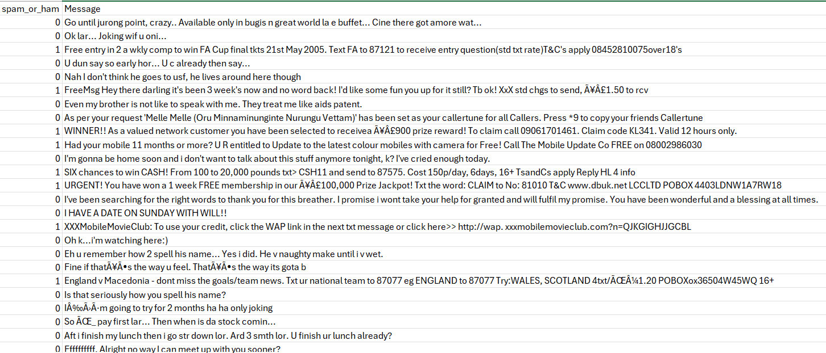
Data Cleaning
Preprocess Text: Convert messages to lowercase, remove punctuation/special characters.
Handle Duplicates and Missing Values: Check for and remove duplicate messages; fill in or remove missing values in "Class" or "Message".
Encode Categories: Transform "Class" into a numerical format for analysis; 0 is Non-Spam, 1 is Spam

Slide 10
Data Mining
Exploratory Analysis: Examine the balance of spam vs. non-spam messages and identify frequent words in each category.
Feature Extraction: Use BoW or TF-IDF to convert text messages into a numerical format that models can interpret.
Model Building: Apply classification algorithms (e.g., Naïve Bayes, Logistic Regression, Random Forest Classifier) to distinguish between spam and non-spam messages.
Evaluate and Optimize: Measure model performance with confusion matrix for Accuracy, Sensitivity, Precision and Specificity.
Footnote Definitions:
BoW (Bag of Words): This method turns text into a list of words without considering the order. Imagine dumping all the words from a message into a bag; each word is counted but where it was in the message doesn’t matter.
TF-IDF (Term Frequency-Inverse Document Frequency): A way to score the importance of words in a message based on how often they appear in that message but less often in all other messages. It helps figure out which words are special in a particular message compared to all messages.

Slide 11
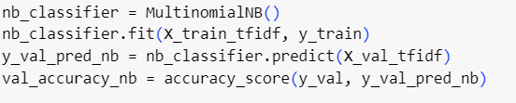
Analytic Techniques
Code used to perform Naïve Bayes classifier.
Explanation of code:
In the Multinomial Naïve Bayes algorithm, the TF-IDF (Term Frequency-Inverse Document Frequency) scores of words are treated as features, and the model assumes that these features are conditionally independent given the class label.
During training, the model calculates the probabilities of each word occurring in each class and the prior probabilities of each class based on the training data.
During prediction, the model uses these probabilities to compute the likelihood of a document belonging to each class and selects the class with the highest likelihood as the predicted class.

Slide 12
Analytic Techniques
Default Parameters of MultinomialNB:
Alpha: 1.0. This value represents the additive (Laplace/Lidstone) smoothing parameter, which is applied to prevent zero probability in situations where a specific class and feature value combination is absent from the training set. An alpha of 1.0 indicates that Laplace smoothing is being used, a straightforward and commonly implemented method of smoothing.
fit_prior: True indicates whether to learn class prior probabilities, which are the likelihoods of each class occurring in the data. If set to false, a uniform prior will be used, assuming that all classes have the same prior probability.
class_prior: None indicates that the prior probabilities of each class can be set manually. If it is set to 'none,' the class priors are calculated from the training dataset.

Slide 13
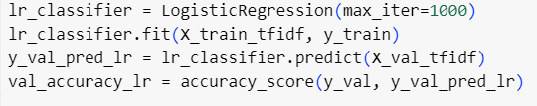
Analytic Techniques
Code used to perform Logistic Regression classifier
Explanation of code:
Logistic regression, in the context of text classification, treats each word's TF-IDF score as a feature. The model calculates a weighted sum of these features, applies a logistic function to the result, and predicts the probability of the document belonging to a particular class.
The logistic regression model is trained to adjust its weights during the optimization process, aiming to find the best decision boundary that separates different classes in the feature space.

Slide 14
Analytic Techniques
“max_iter=1000: This parameter determines the maximum number of iterations the algorithm will execute to find the optimal coefficients for the logistic regression model. It is set to 1000 to provide sufficient iterations for convergence on a solution, particularly when the data is complex or demands extensive processing for an accurate model.
“X_train_tfidf”: This refers to the training data that has been converted into a TF-IDF matrix, which indicates the importance of words within the documents.
“y_train”: It contains the actual classifications for each document in the training set.

Slide 15
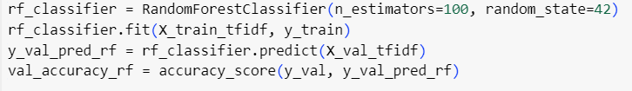
Analytic Techniques
Code used to perform Random Forest classifier
Explanation of code:
In text classification, each decision tree in the Random Forest is trained on a random subset of the training data and a random subset of the TF-IDF features. This randomness helps prevent overfitting and improves the generalization of the model.
During prediction, each decision tree independently predicts the class for a given document. The final prediction is often determined by taking average predicted probabilities from all the trees.

Slide 16
Analytic Techniques
“n_estimators=100” means the Random Forest uses 100 decision trees to make its predictions. More trees can lead to better accuracy but also require more computation.
“random_state=42” is used to make the results reproducible. It ensures that every time you run this code, the Random Forest algorithm will start from the same random seed and produce consistent results.
“X_train_tfidf” is the training data transformed into TF-IDF scores, highlighting the importance of each word in the texts.
“y_train” contains the correct classifications for the training texts.

Slide 17
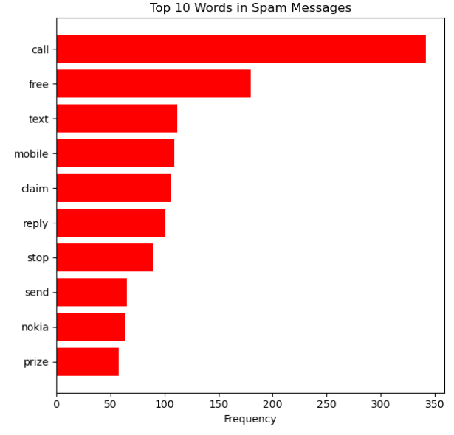
Data Visualization
This image displays a bar chart showing the frequency of the most common words found in spam messages after data cleaning, with “call" being the most frequent word among the listed top 10.

Slide 18
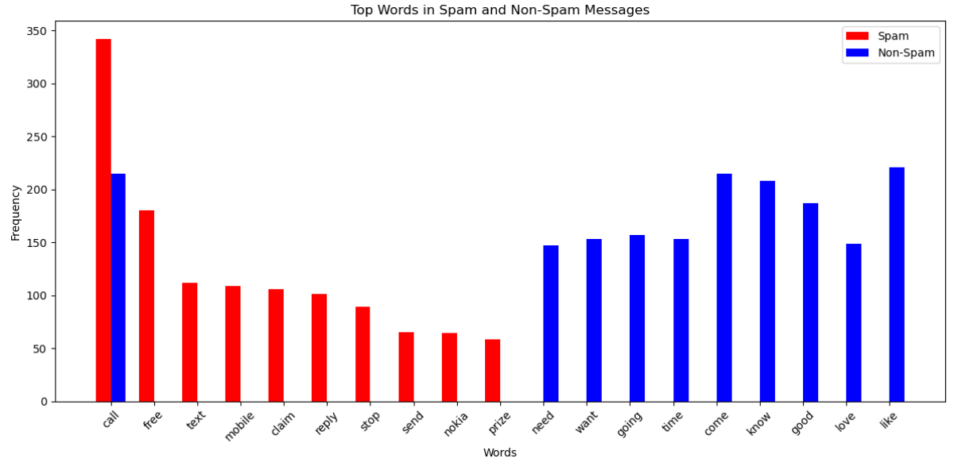
Data Visualization
This graph shows the Comparison of top words in Spam and Non-Spam

Slide 19
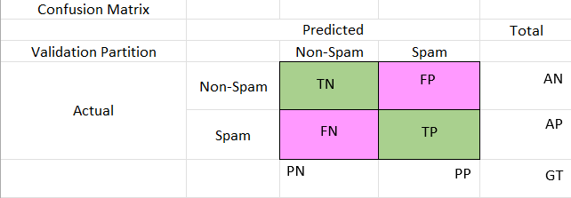
Statistics
True Positive (TP): The message is predicted as Spam and the actual identified is Spam.
True Negative (TN): The message is predicted as Non-Spam and the actual identified is Non-Spam.
False Positive (FP): The message is predicted as Spam but the actual identified is Non-Spam.
False Negative (FN): The message is predicted as Non-Spam but the actual identified is Spam.

Slide 20
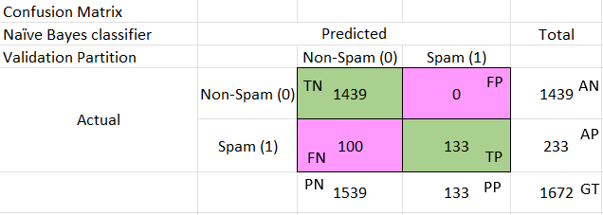
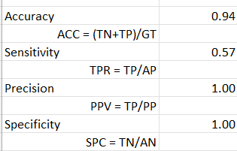
Statistics - continued
Training the model using Naïve Bayes classifier.
Validating the model performance in the Validation dataset.
Confusion Matrices and Model evaluation: 0 is Non-Spam, 1 is Spam.

Slide 21
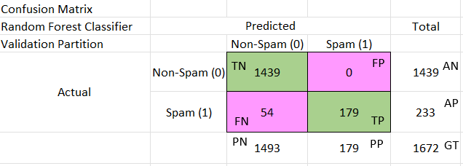
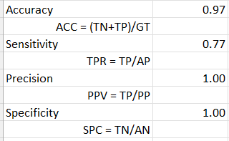
Statistics - continued
Training the model using Random Forest Classifier.
Validating the model performance in the Validation dataset.
Confusion Matrices and Model evaluation: 0 is Non-Spam, 1 is Spam.

Slide 22
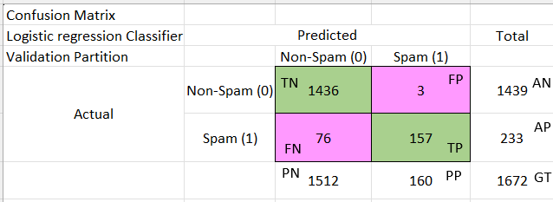
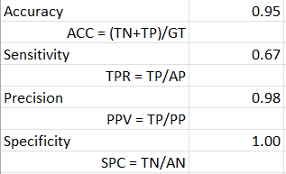
Statistics - continued
Training the model using Logistic Regression Classifier.
Validating the model performance in the Validation dataset.
Confusion Matrices and Model evaluation: 0 is Non-Spam, 1 is Spam.

Slide 23
Summary
 | Naïve Bayes classifier | Random Forest Classifier | Logistic Regression Classifier
Accuracy | 0.94 | 0.97 | 0.95
Sensitivity | 0.57 | 0.77 | 0.67
Precision | 1.00 | 1.00 | 0.98
Specificity | 1.00 | 1.00 | 1.00

Slide 24
Statistics - continued
Model Evaluation: Random Forest was considered the best classifier based on its validation accuracy compared to Naive Bayes and Logistic Regression. However, model selection should not solely rely on accuracy, and other metrics like precision, recall, and F1-score should also be considered. Additionally, cross-validation can help in selecting the best model.
Random Forest combines the predictions of multiple decision trees to make a final decision, which often results in better performance.

Slide 25
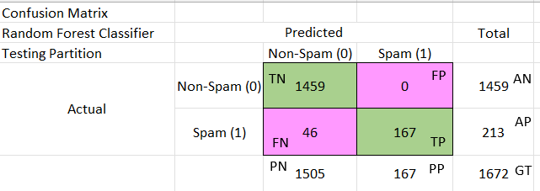
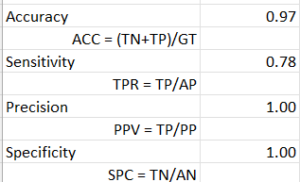
Advanced Analyses
Testing the model using Random Forest Classifier
Testing the model performance in the Testing dataset.
Confusion Matrices and Model evaluation: 0 is Non-Spam, 1 is Spam
Because of the dataset; a baseline of simply predicting all messages as Non-Spam would be correct 87% of the time. The model improves on that by predicting correctly 97% for the test partition (and having a much better sensitivity percentage).

Slide 26
Roadblocks & Challenges
Collecting the data and the frequently used keywords from the text messages that are suspected as spam messages.
Arranging the data patterns in a way that the classifier methods can collect the correct data and provide the required output.

Slide 27
Next Steps
To do further study of modifying hyper parameter values including threshold.
To do study on handling imbalanced data sets in machine learning methods and how it is affecting the results.
To do study on the AUC metric to assess the model's classification performance.
To do study using word embedding in spam detection.
Description: Word embeddings (e.g., Word2Vec, GloVe) offer a dense representation of words based on their context, capturing semantic relationships between words.
Application: Use embeddings to enhance feature vectors, allowing the model to understand similar words and contexts, improving the detection of subtly different spam messages.

Slide 28
Conclusion
The Random Forest Classifier performs well across various metrics, demonstrating reliability in distinguishing between spam and non-spam instances. The balanced nature of accuracy, sensitivity, precision, and specificity suggests that the Random Forest Classifier approach is effective in handling the complexities of the dataset. Regular monitoring and potential refinement of rules may further enhance the model's performance in real-world applications.
The model that works with our data was determined to be a Random Forest Classifier.

Slide 29
Thank you

